Slide 1
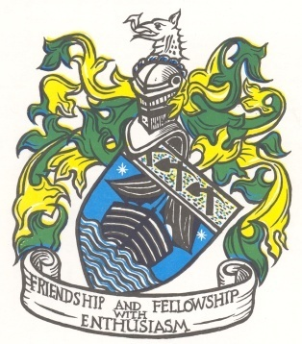
Braund Family + New Zealand
Waikanae Reunion 5 – 8 April 2019

Slide 3
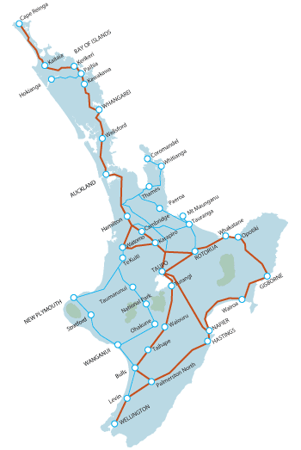
NORTH ISLAND BRAUNDS
Wellington

Slide 4
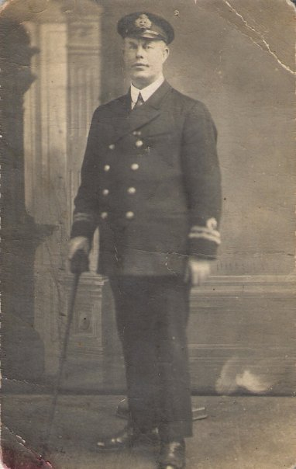
William George Braund
Half - Brother of Captain James Braund
Sailed out of Wellington and Westport

Slide 5
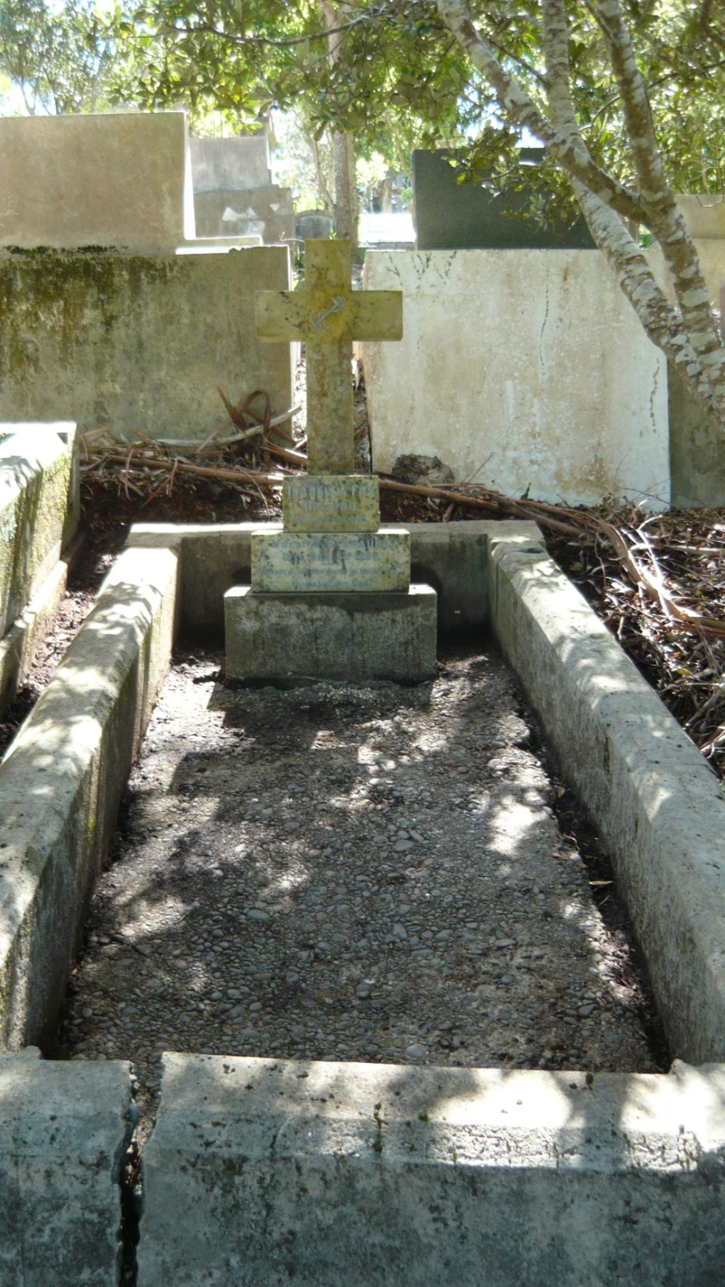
Isabella Fry Braund
1st Wife
William George Braund
Buried: Karori Cemetery, Wellington
On the Centenary of her death
2 November 2008

Slide 6
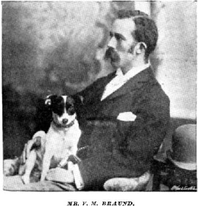
Victor Braund, Wellington

Slide 7
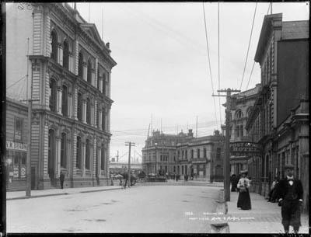
Offices in Grey Street

Slide 8
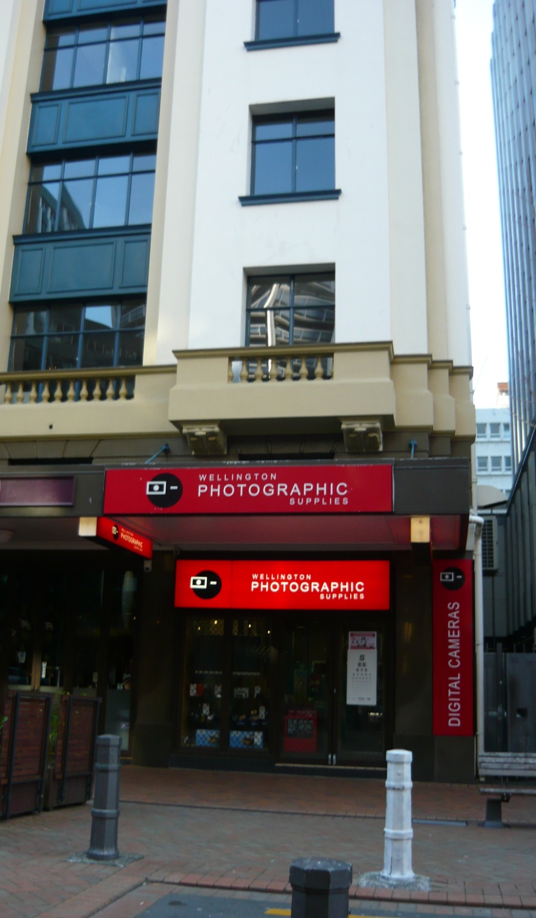
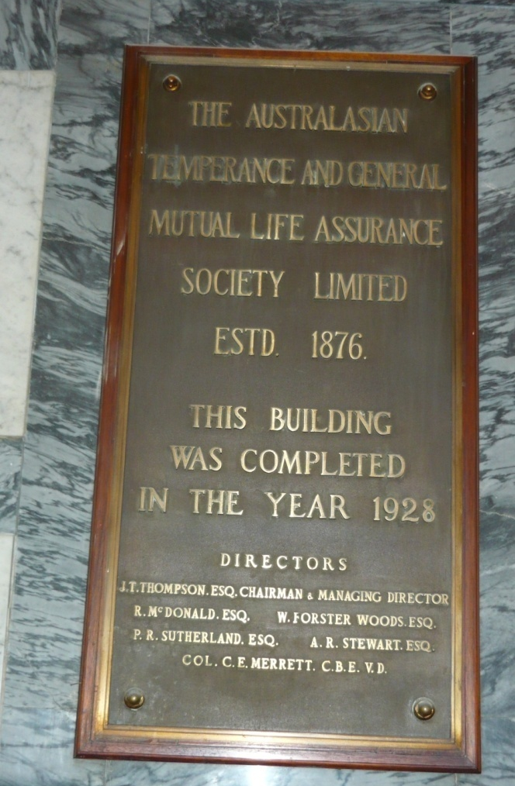
Grey Street location
August 2009
Site rebuilt in 1928

Slide 9
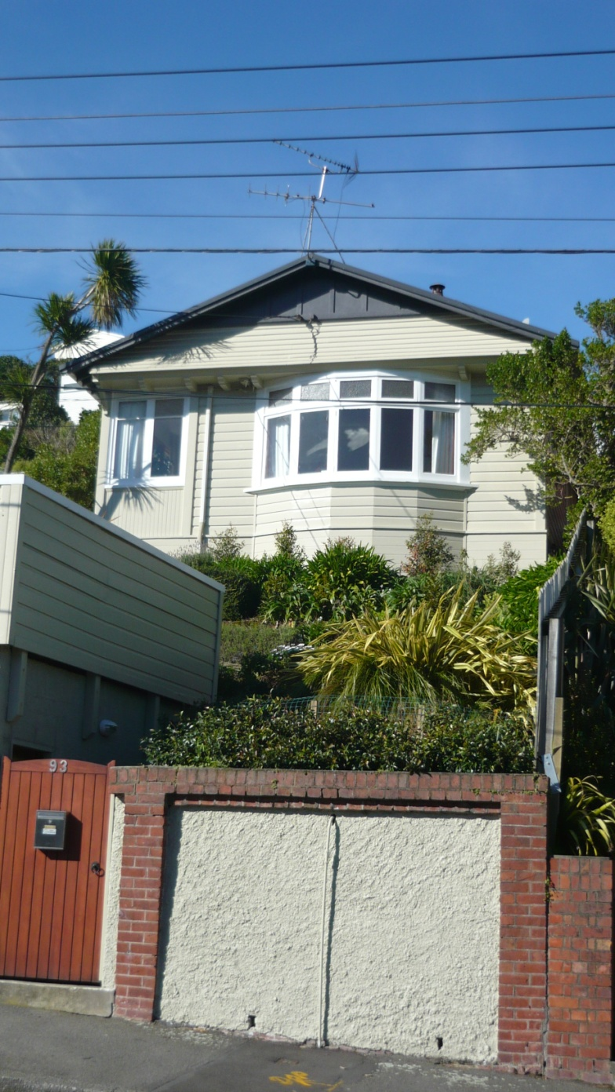
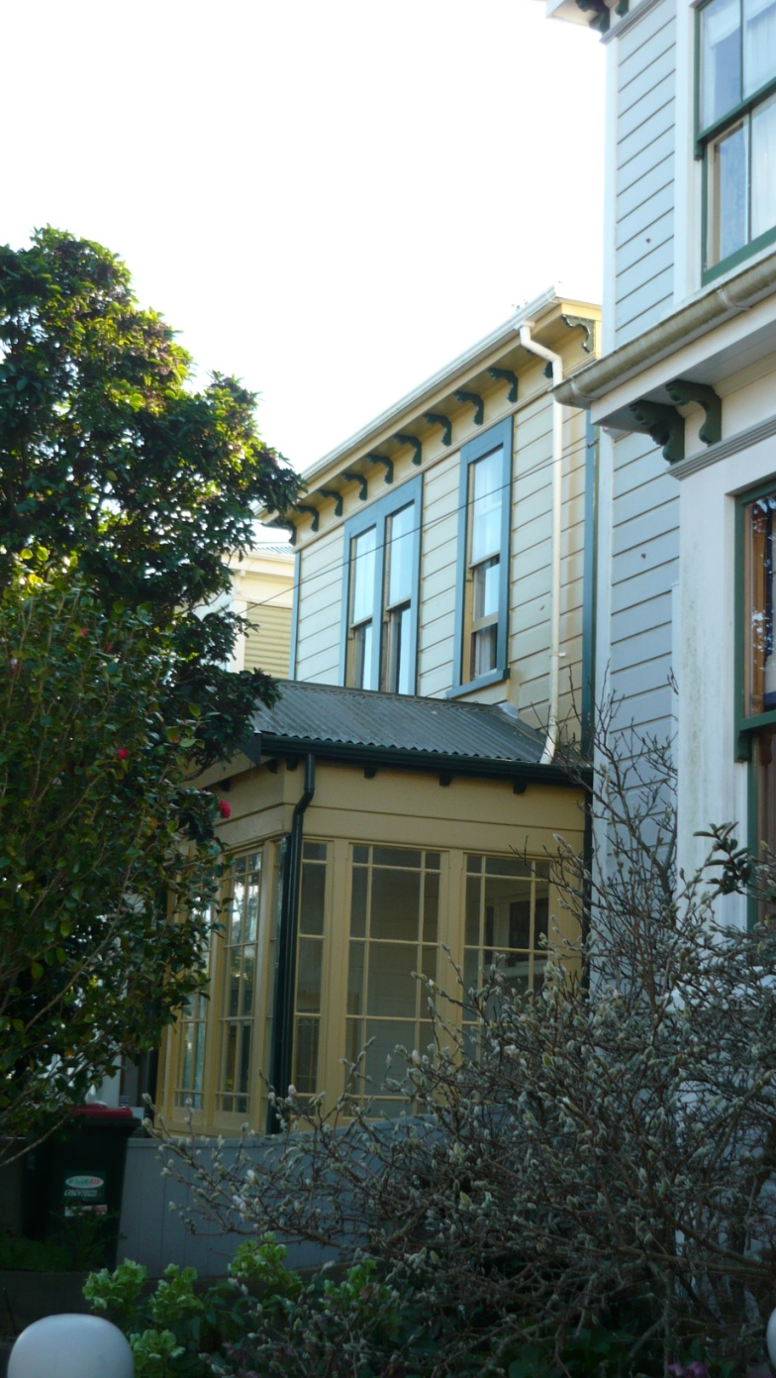
Victor’s Houses, Wellington – August 2009

Slide 10
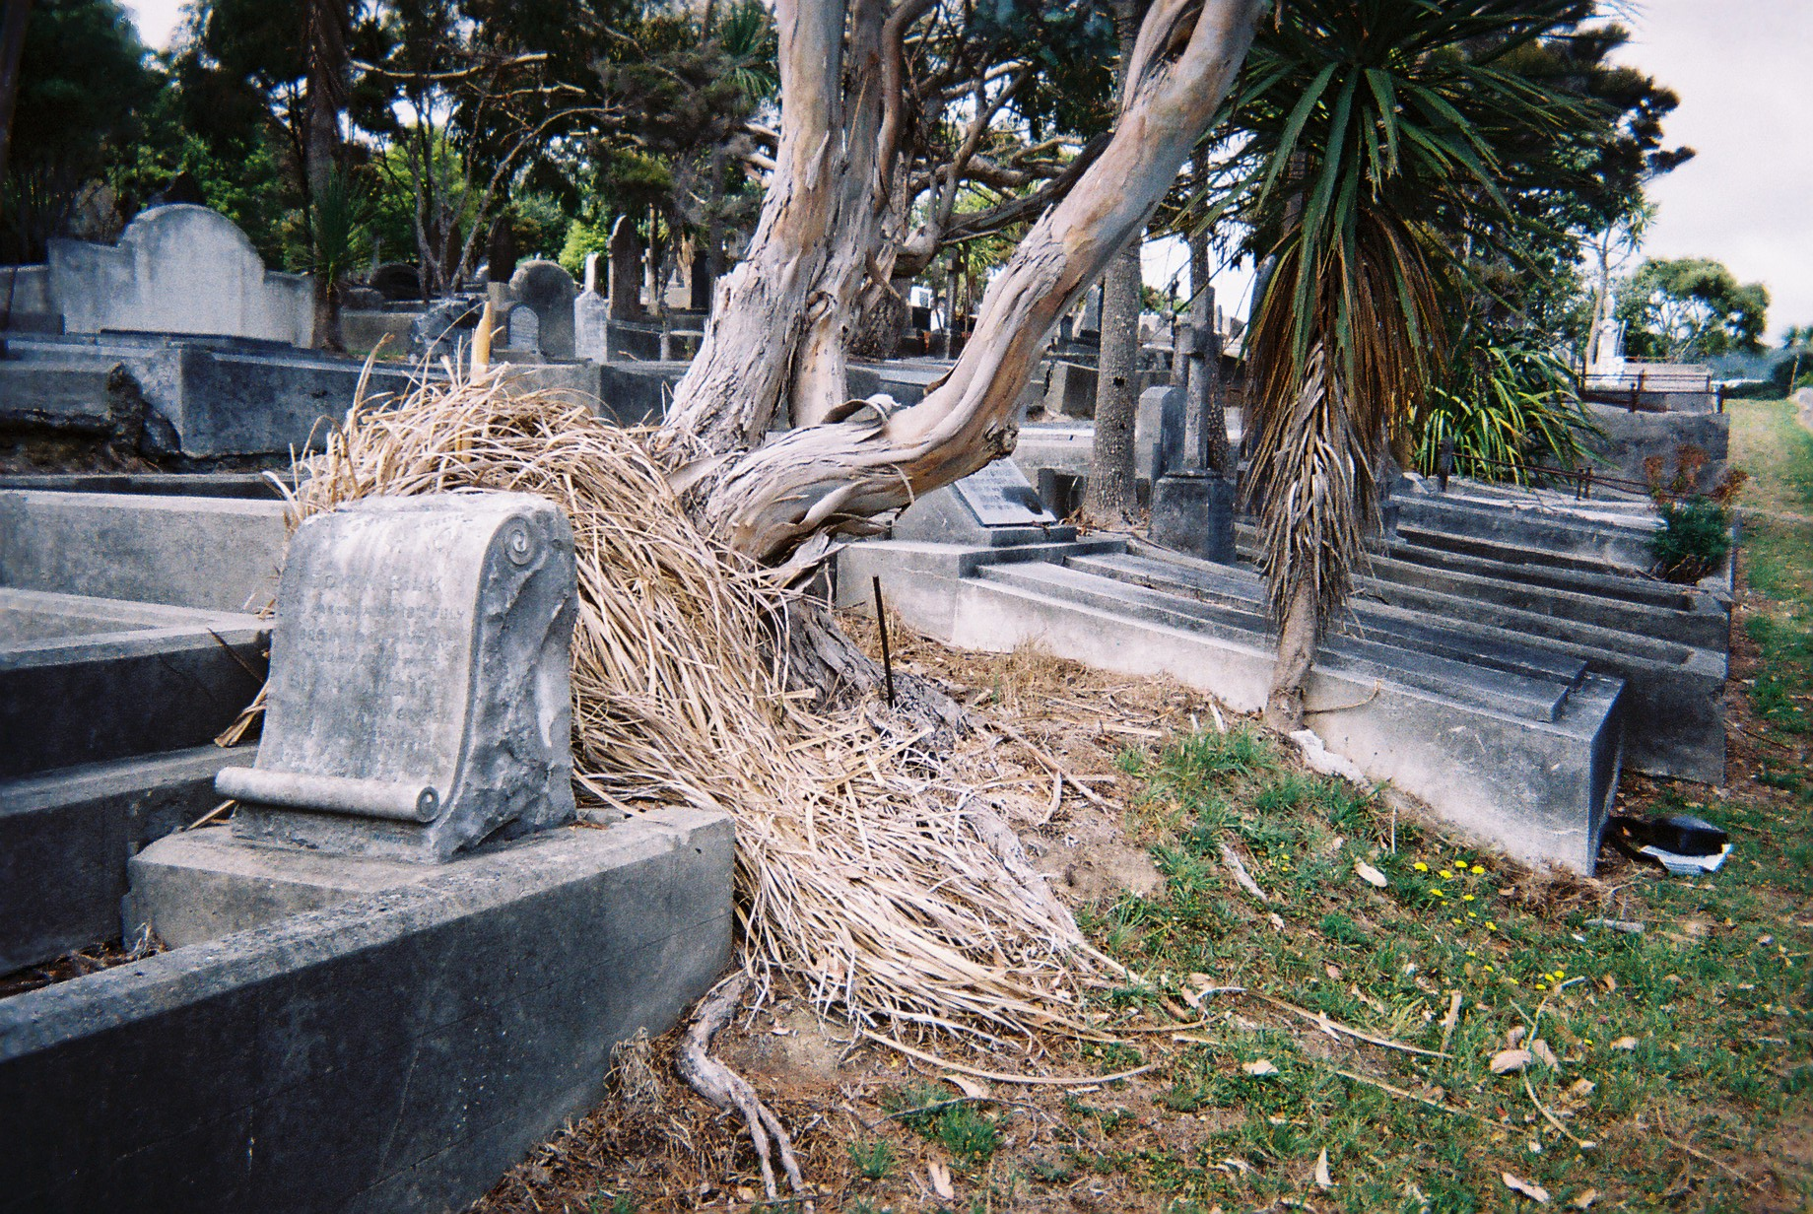
Karori Cemetery, Wellington

Slide 11
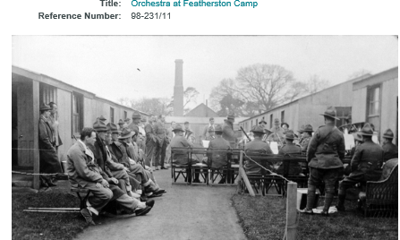
Leonard Albert Ponsonby Braund
Masterton District Library Archive
http://masterton.spydus.co.nz/cgi-bin/spydus.exe/FULL/OPAC/ARCENQ/8746459/39911653,1?FMT=IMG
Grandson of Captain James Braund
Son of Alby Braund

Slide 12
Auckland and North of Wellington

Slide 14
Braund Family – Branch 2
Captain James Braund
Married (2): Mary Horne
Mary Ellen
Joseph Norman
Married (1): Mary Dennett
Mary Matilda (Minnie)
Robert
Albert Edwin (Alby)
James (Jim)
William James (Australia)
Phoebe Elizabeth
MM
Alice Maud Mary
George Dennett
(New Plymouth)
Married:
Alice Tunbridge
Zeta
Gladys
Alma
Married:
Elizabeth Ella Snook
Norma
Laurence
Joseph
Drowned
Age 3 years
Died
Age 3 1/2 months
Married
Eleanor Mary Boulter (Nell)
Leonard
Thetis
Mavis
Beryl
Owen
Married:
Mary Lillian
Mary Ellen
Lillian Stuart (Dickie)
Muriel
Married:
James Bent Warner
Married:
Catherine Blewitt
Died
Age 2 months
Died
Age 3 months
Married (1):
Elizabeth Norman
Joseph Braund Junior
Married (2):
Anne Elizabeth Fry
William George Braund
Married( 1): Isabella Fry
Married (2):
Mabel Stephenson

Slide 15
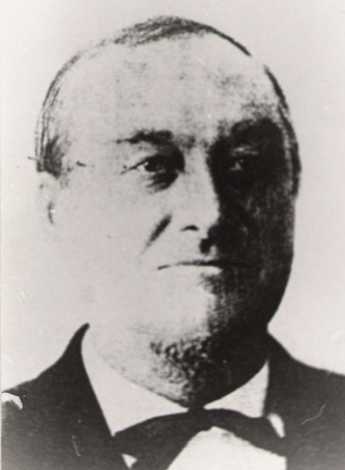
Captain
James
Braund
Arrived Auckland 1856
Via Napier
Died Auckland 1897
Owner of the trading ships and yachts
Surprise
Albatross
Charybdis
Vision
Southern Cross
Golden Crown

Slide 16
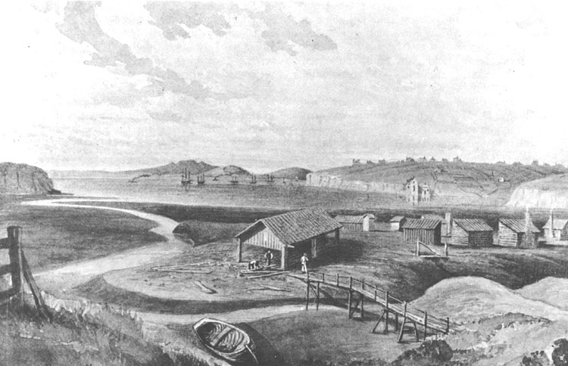
A portrait (water-colour) of Freeman's Bay in 1860, by John Kinder. The foreground marshland and much of the background wetland, extending well out into the water shallows, had to be laboriously reclaimed over many decades of very hard work and continuous landfilling. By 1860 some houses dotted the skyline on the high ground ridge along which Hobson Street was constructed.
Captain Braund lived in Graham Street, Freeman’s Bay

Slide 17
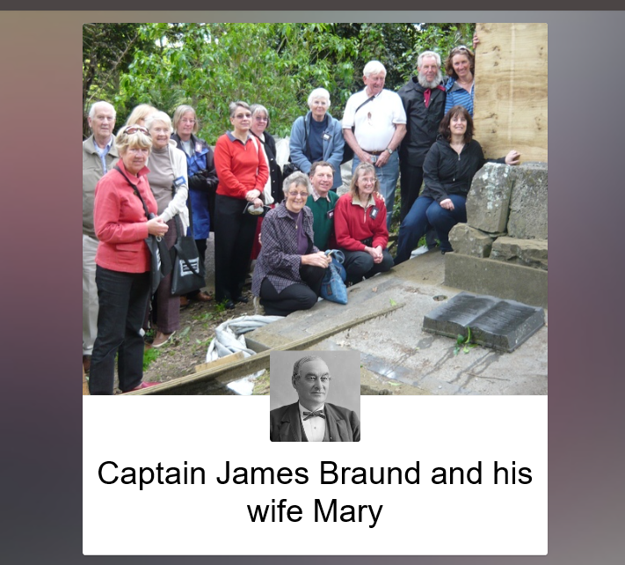
Symonds Street Cemetery
https://discover.stqry.com/v/5-graves-of-interesting-people/s/3b4316cc-5b9e-4d70-97c8-4d7e939e9e8a

Slide 18
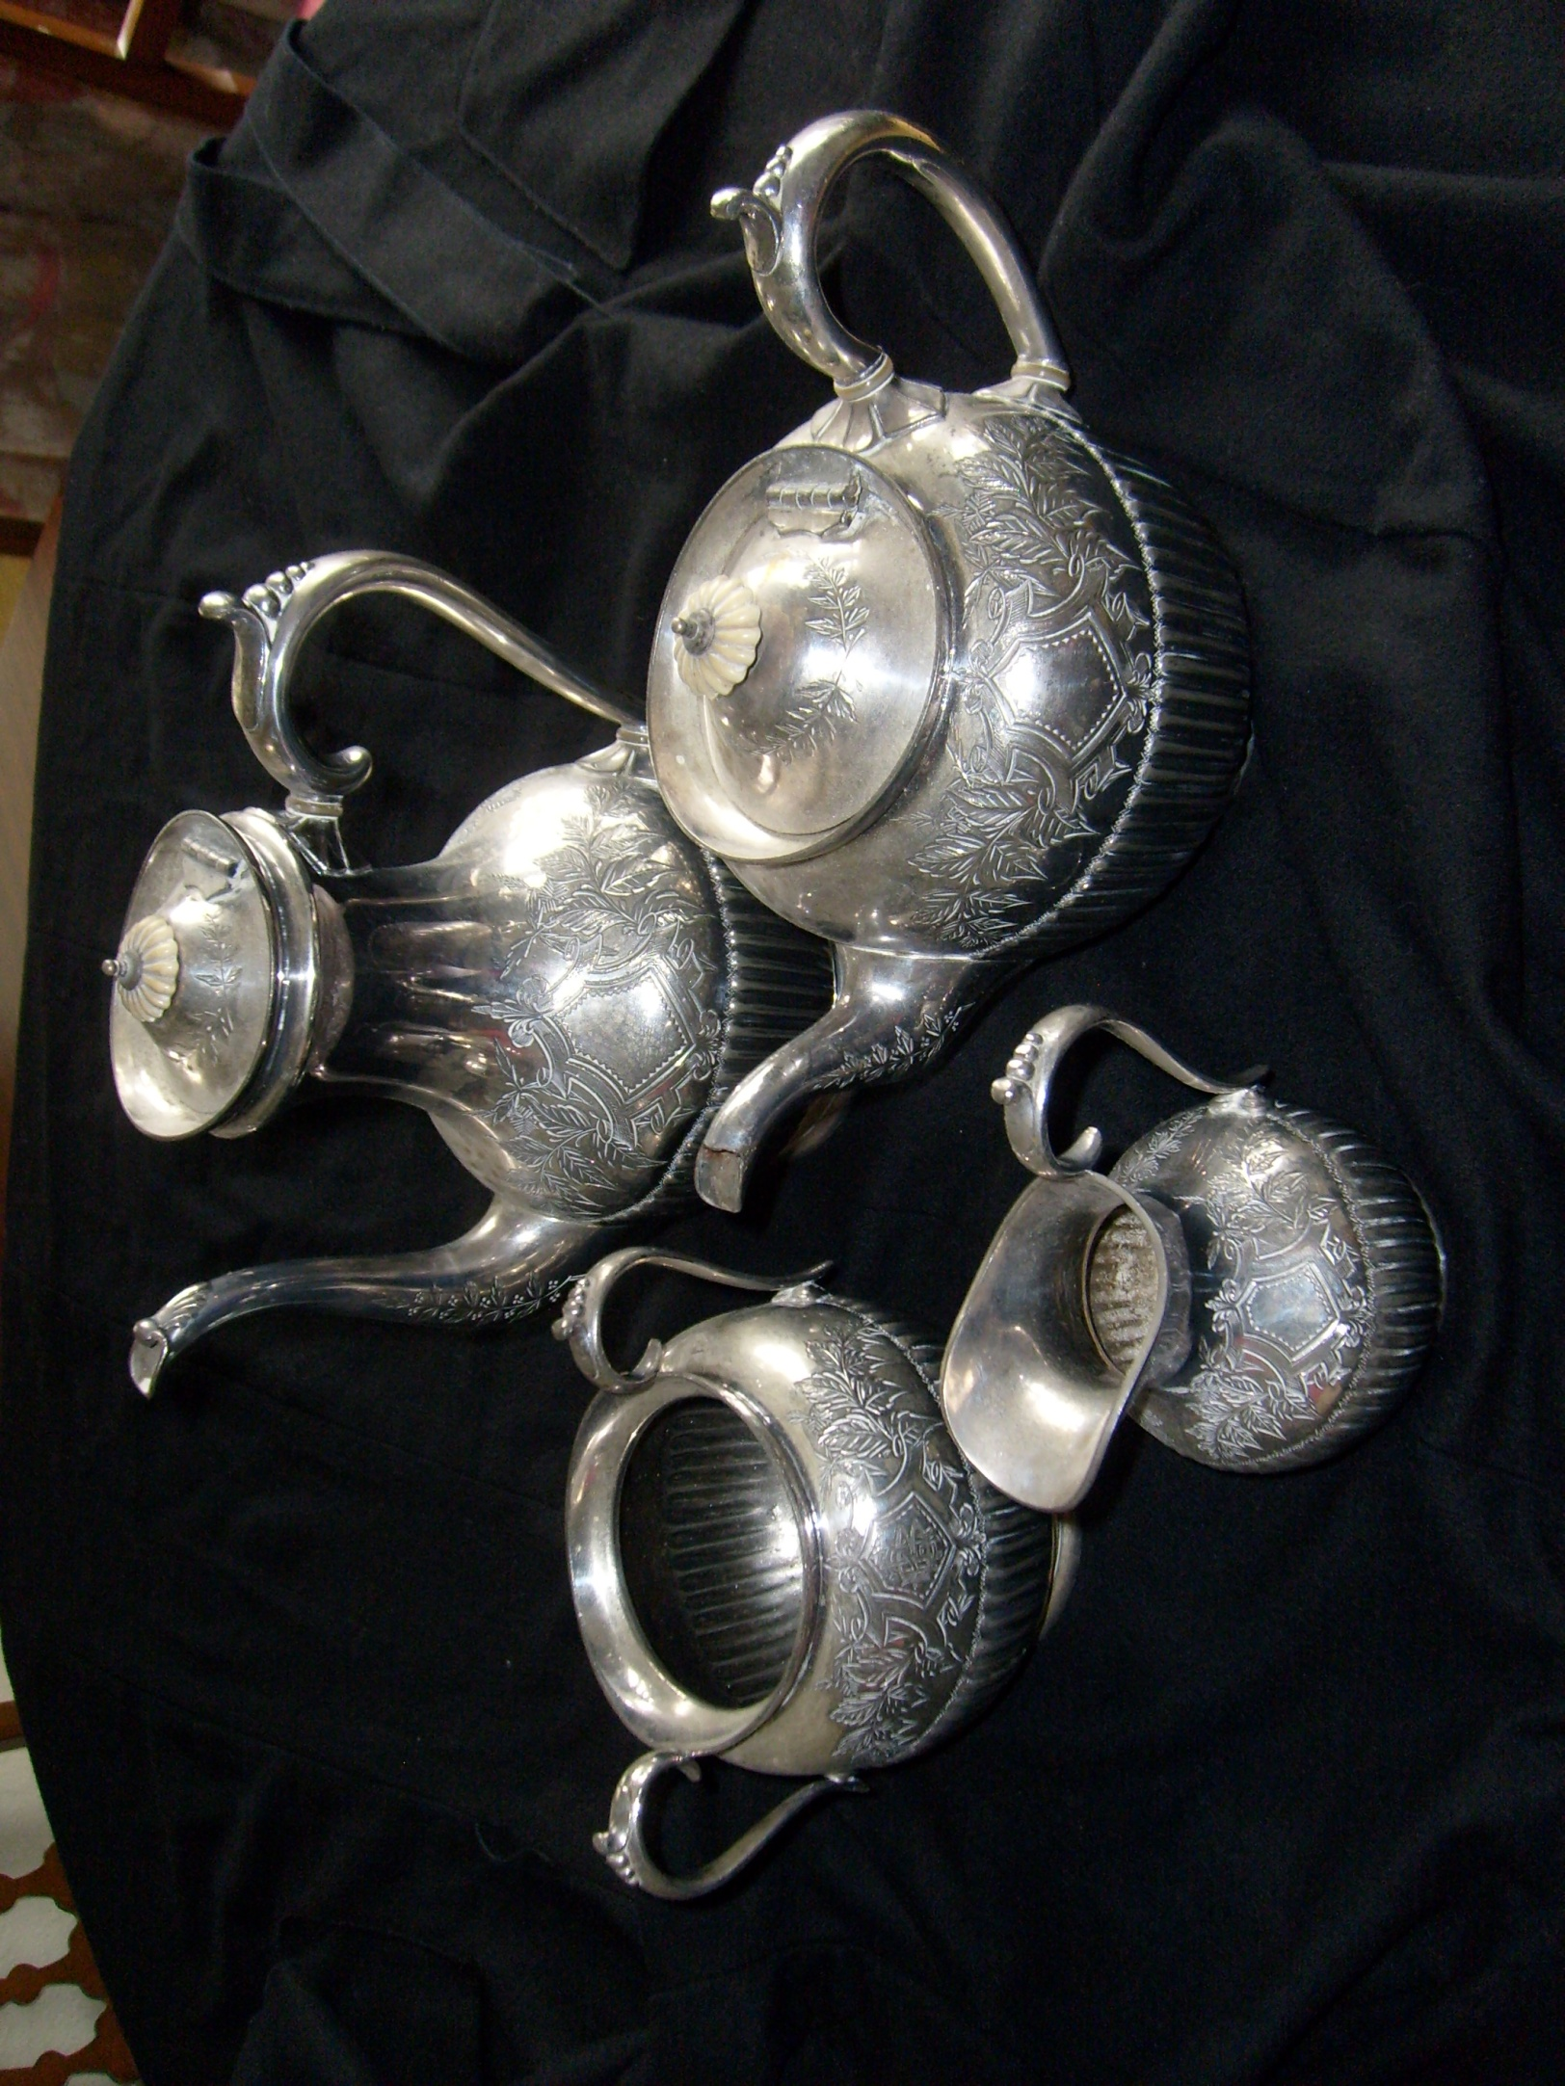
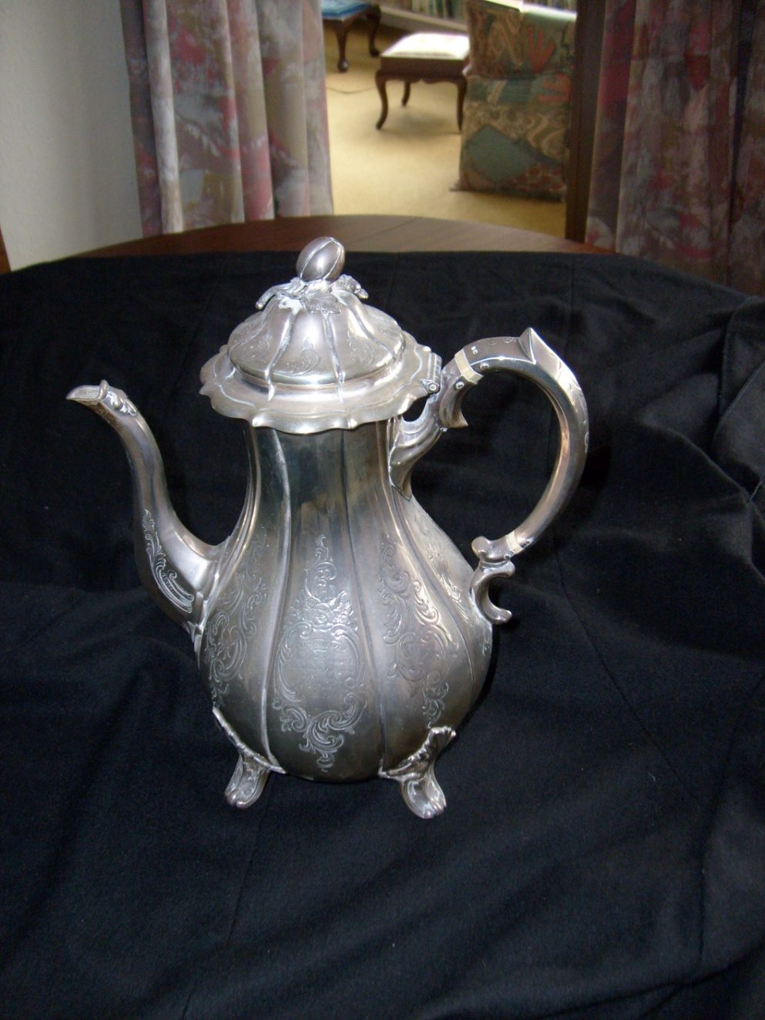
Presented to
Captain & Mrs Braund
by
George,
Earl of Pembroke
April 1869
Captain Braund took the Earl and George Kingsley on a tour of the Pacific in his ship Albatross before being shipwrecked on the Ringgold Islands
(Ruve Grant)

Slide 19
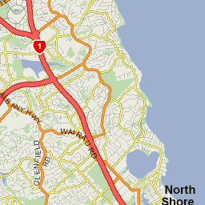
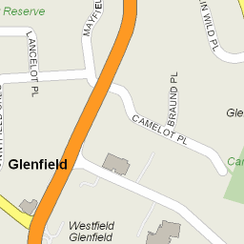
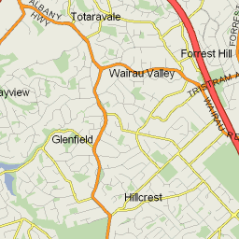
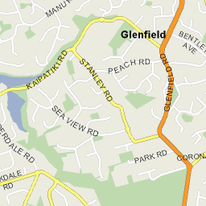
Braund Place
Glenfield, North Shore, Auckland

Slide 20
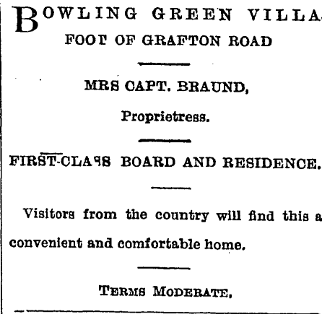
Page 20 Advertisements Column 2
Observer, Volume XVI, Issue 983, 6 November 1897, Page 20
Mary (Horne)
Braund
2nd wife
Captain James
Braund
D: 25 February 1931 Age 85

Slide 21
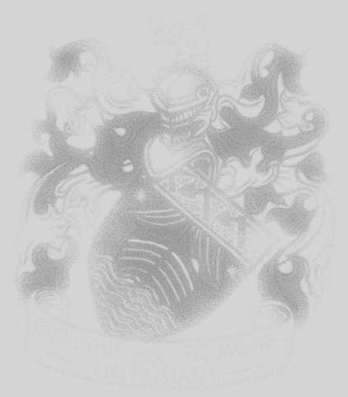

Captain James’ family

Slide 22
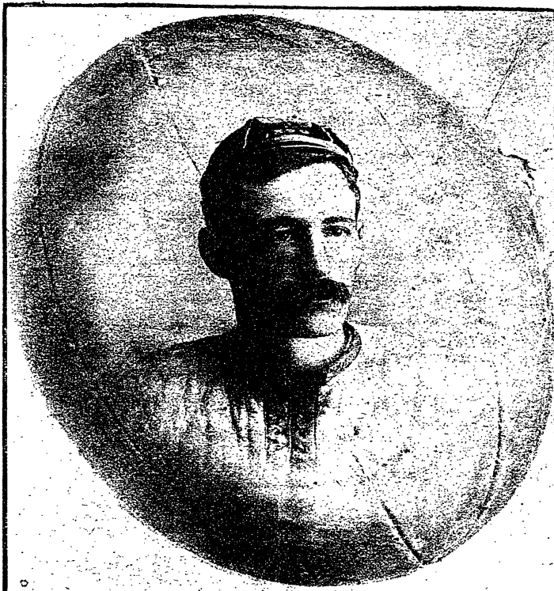
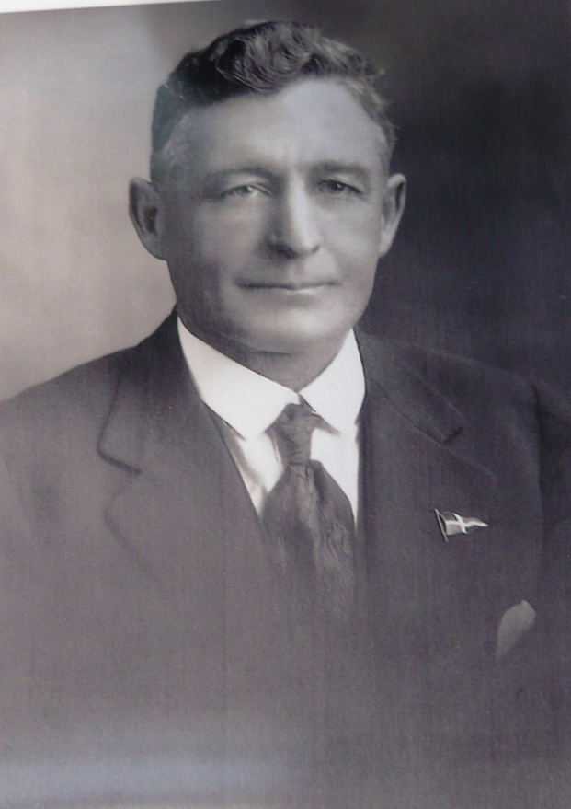
Albert ‘Alby’
Braund
Son of Captain James Braund
Rugby Player Sailor
Marine Engineer
Commodore

Slide 23
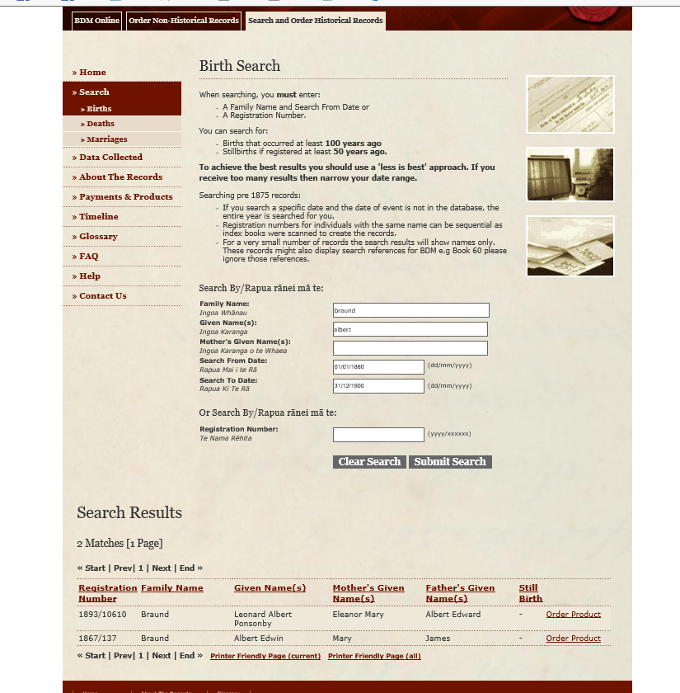

Slide 24
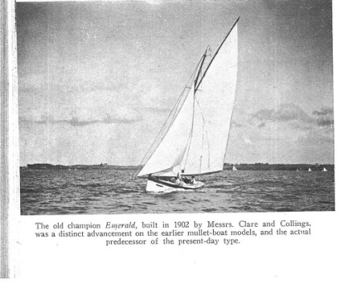
Emerald – sailed by Alby Braund

Slide 25
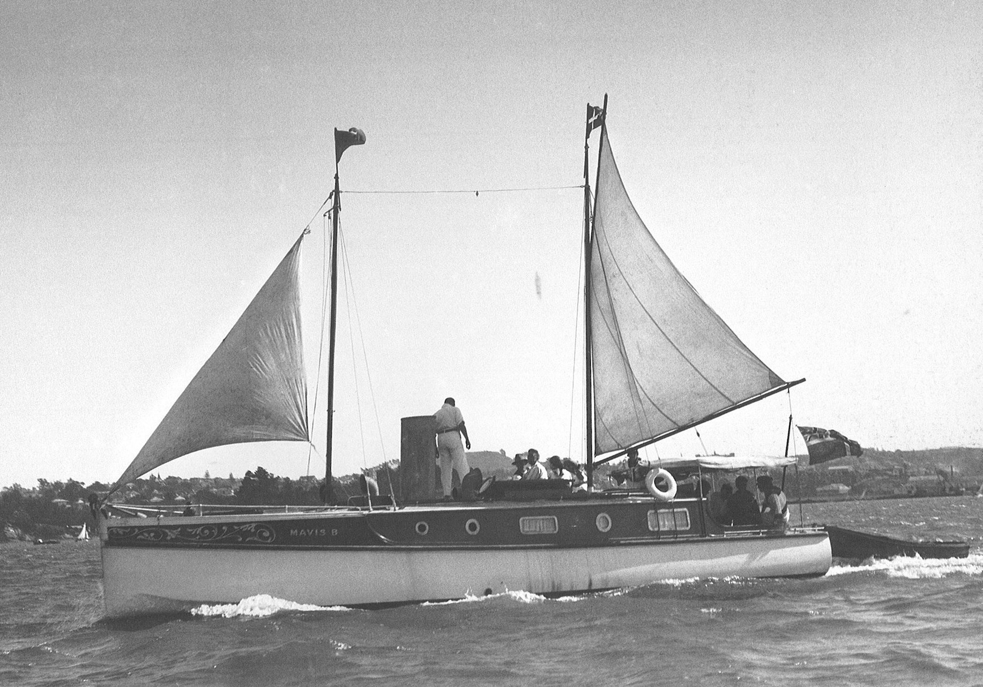
Commodore, Akarana Yacht Club, Auckland
Alby Braund’s ‘Mavis B’ by Henry Winkelmann on the Waitemata Harbour
Albie Braund Cup
Auckland Anniversary Regatta
“Among the tall, wide, short and oddly shaped cups, the biggest would have to be the golden 1938 Alby Braund Cup”
NZ Herald article 28 January 2005
Boating New Zealand Magazine, January 2001 (and photo)
“Mavis B was built for the famous rugby player and mullet boat yachtsman Albie Braund who constructed his own 15hp steam engine for the boat. Although Mavis B was regarded at the time with nostalgic affection because she was latter-day steamer, the installation developed insufficient power for the husky tuck stern hull despite a new boiler and a new engine in 1912. Peter A Smith of St Mary’s Bay installed a 20hp Alpha oil engine for Braund in 1916, but she retained her distinctive funnel for the exhaust.”
History of Royal Akarana Yacht Club (Picture of Mavis B, page 8)
“Not all flag officers took to sail. Vice-Commodore Albie Braund was a frequent visitor to many parts of the Gulf in his magnificent steam launch, Mavis B. She is seen here in picnic mode at Herald Island in 1911”.

Slide 26
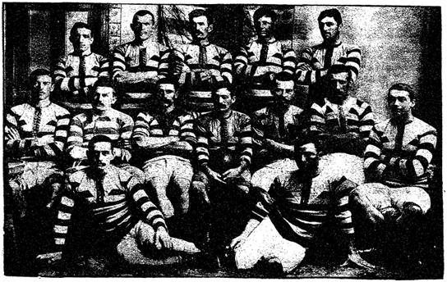

Slide 27
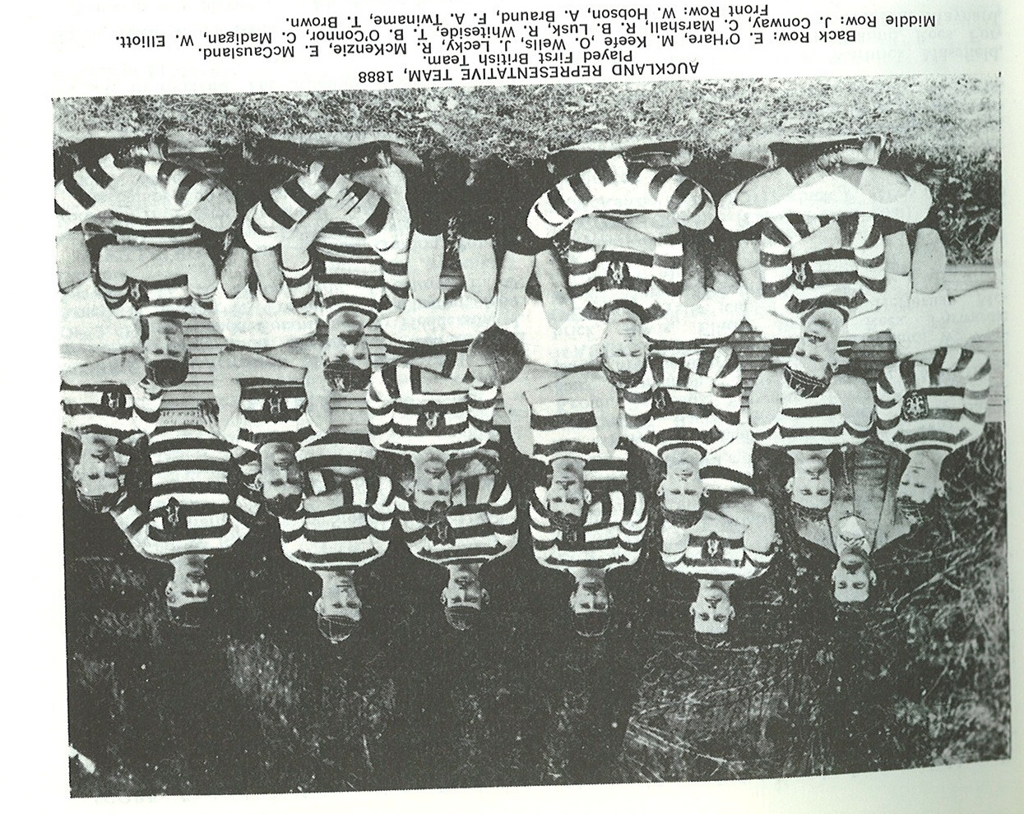
Auckland team that played the first British Touring team
4 games:
3 to 1 in favour of the touring team

Slide 28
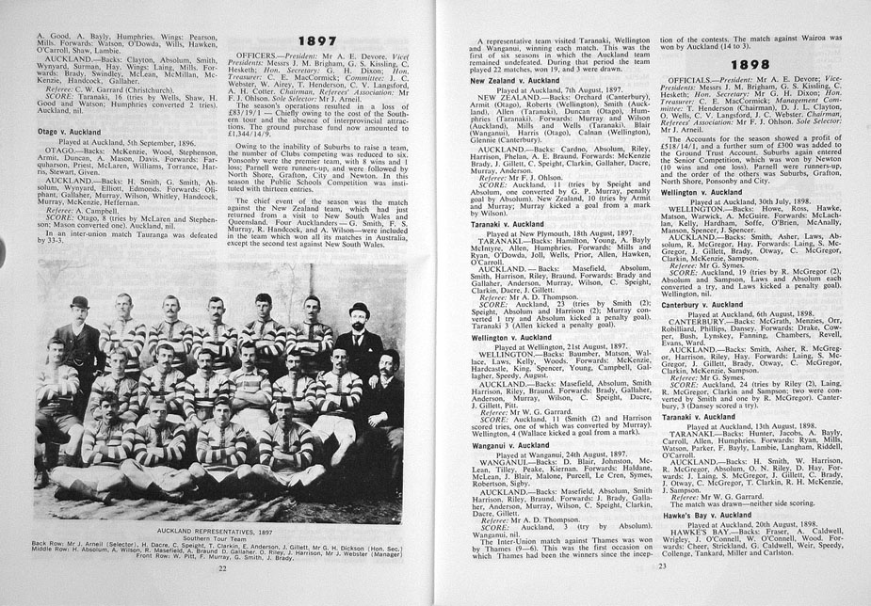

ARFU - 100 Years of Rugby

Slide 29
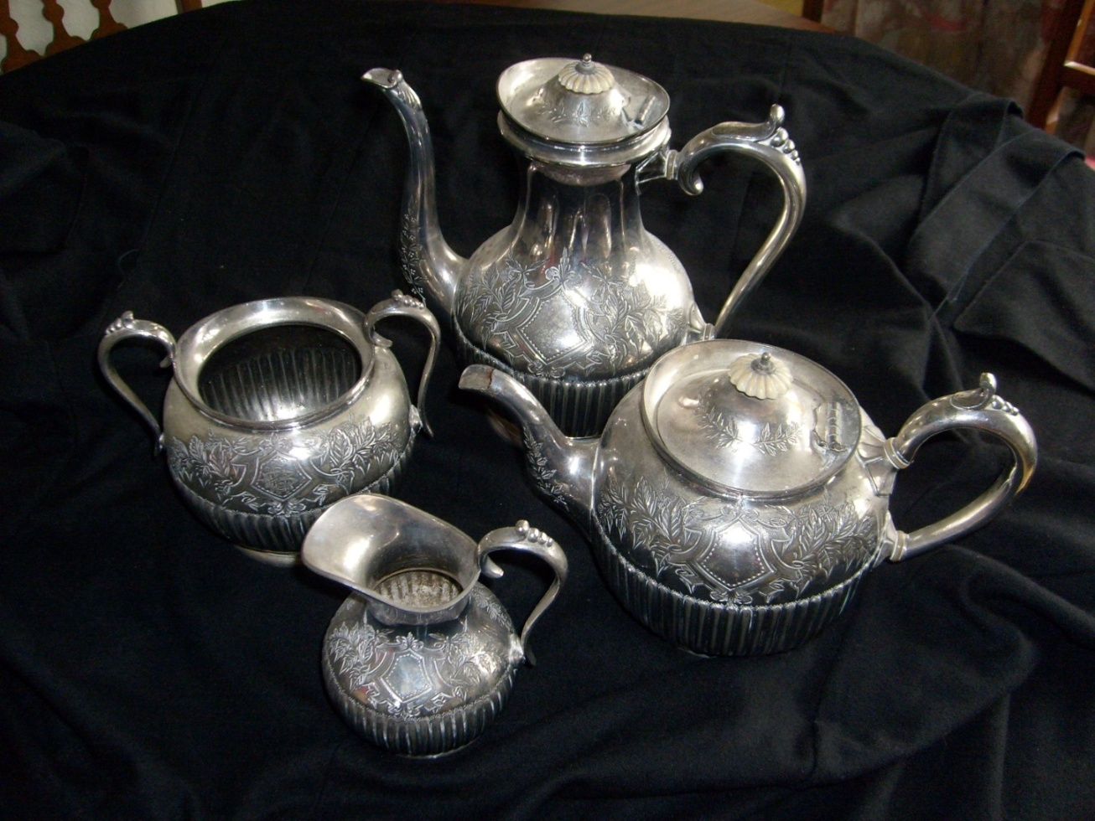
Presented to
A E Braund
By the
Footballers of Auckland for 10 years of service as a representative of the province
November 1897

Slide 30
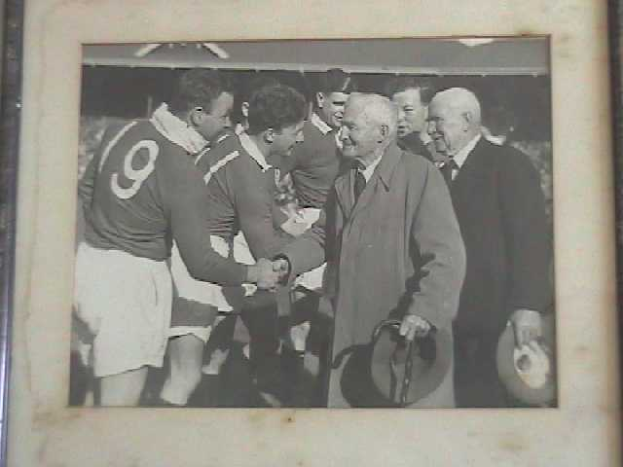
WL Elliott and Alby Braund meeting
1950 British Lions Kyle, Williams, Mullen, Evans.

Slide 31
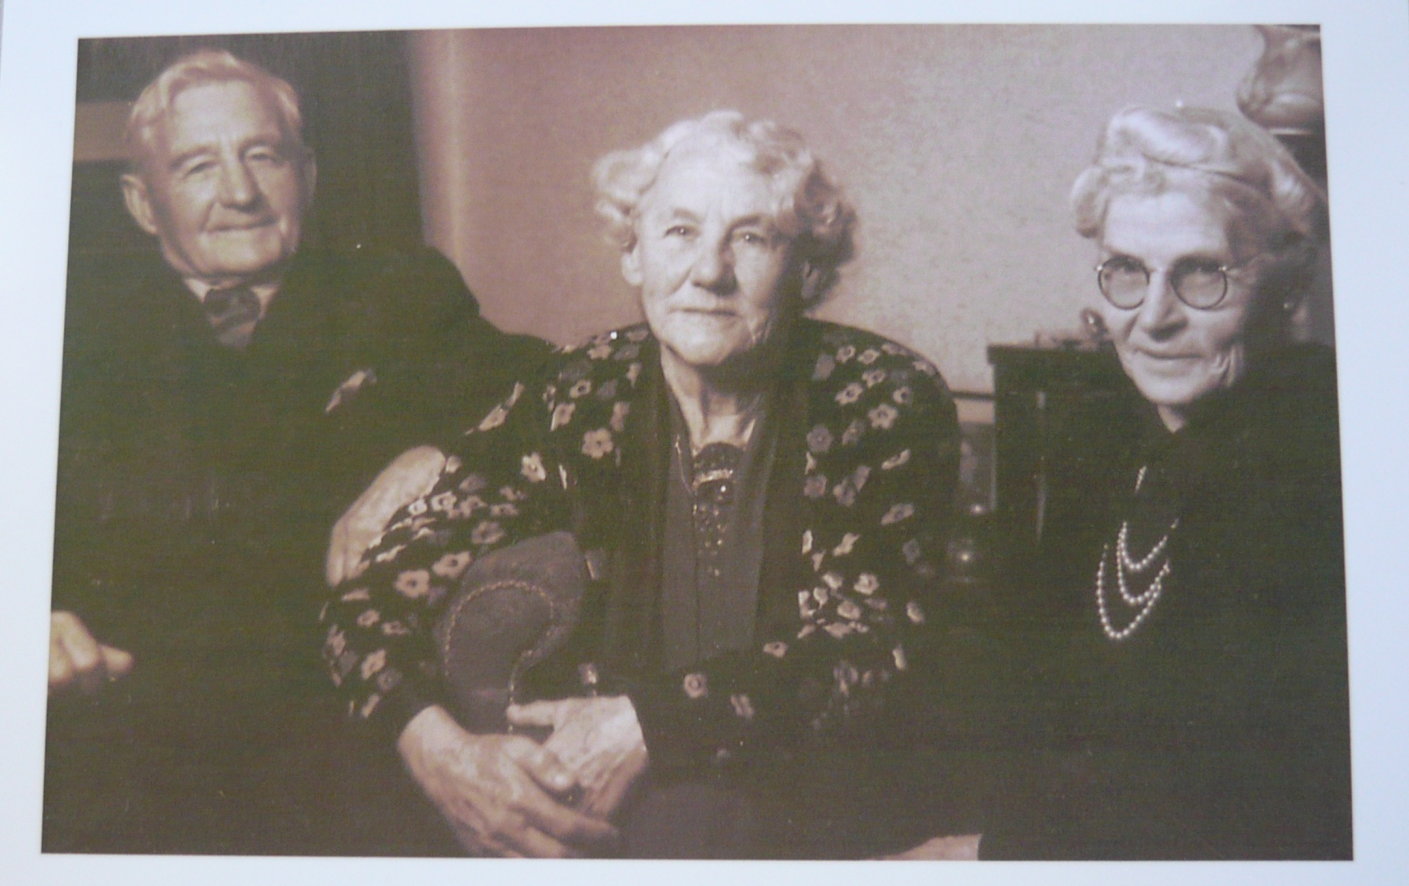
Alby and Eleanor Braund, Agnes Grant

Slide 32
James (Jim) Braund

Slide 33
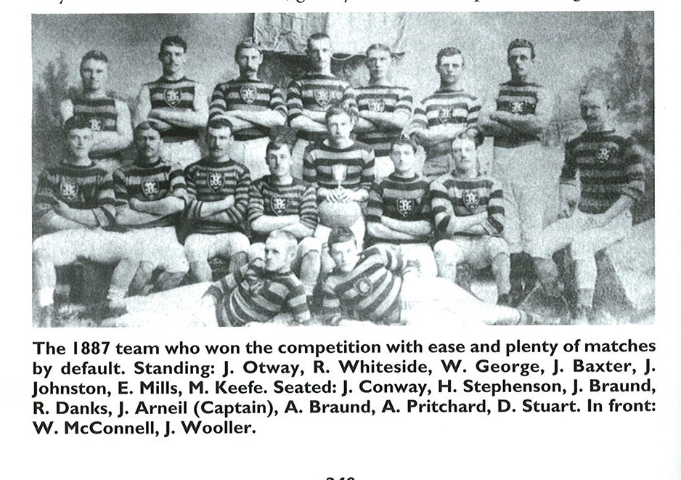
Ponsonby Rugby Club
-
The Winning Team
1887
Jim
and
Alby
Braund
(from Ponsonby Rugby Club History)

Slide 34
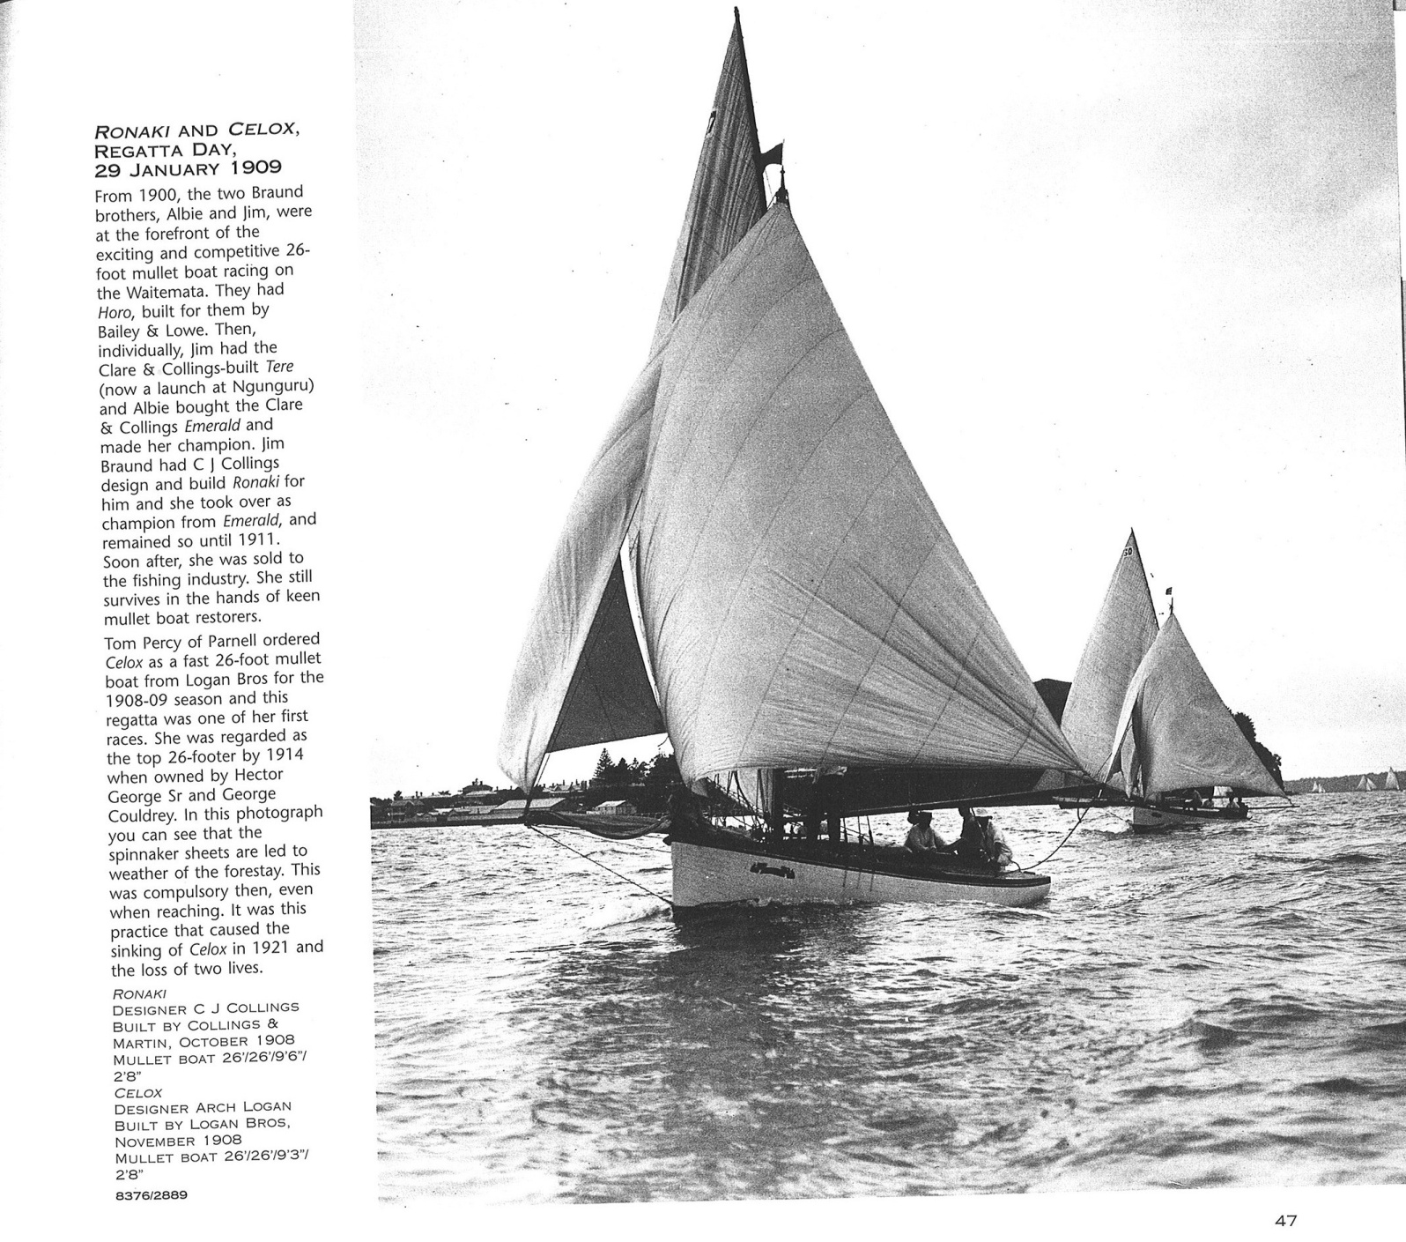
Jim Braund and his winning boat ‘Ronaki’ by
Henry Winkelmann

Slide 35
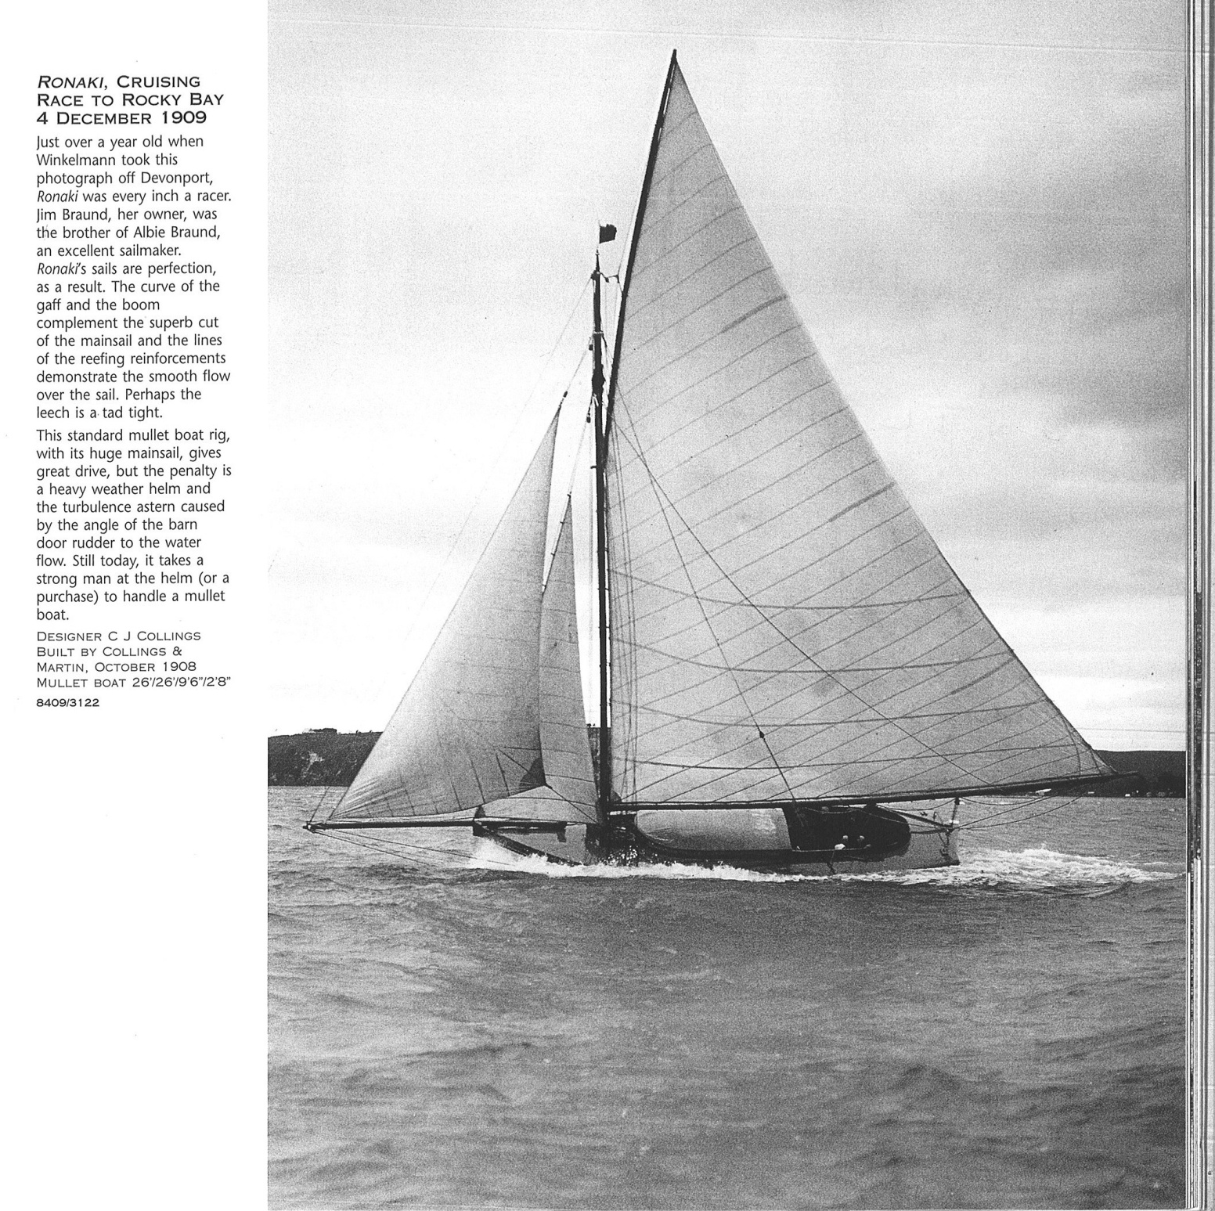

Slide 36
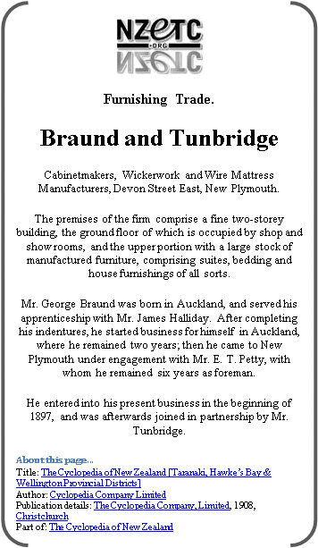
George Dennett Braund
Furniture Maker and retailer
New Plymouth

Slide 37
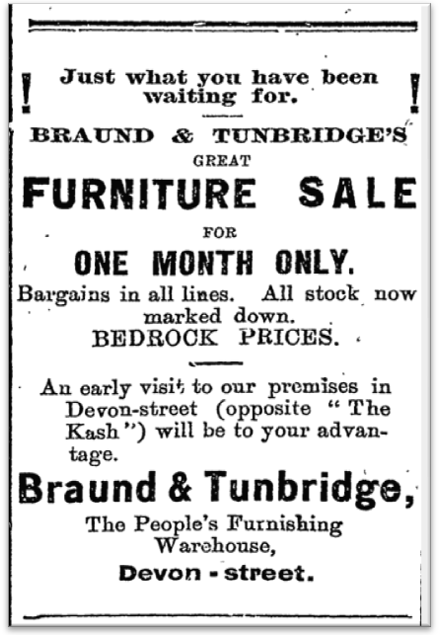
Devon Street
New Plymouth
1906
Devon Street
New Plymouth
1897

Slide 38
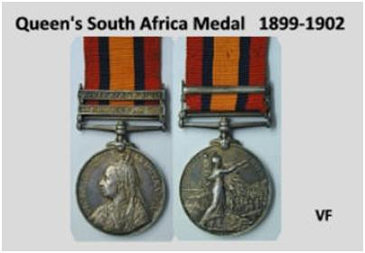
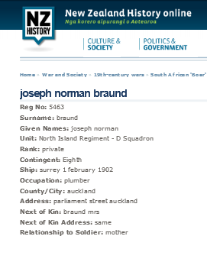
Joseph Norman Braund
At the time of their auction in 2008/9
Queen’s South Africa Medal 1899-1902
2 clasps “TRANSVAAL, SOUTH AFRICA 1902”,
impressed naming to “5463 TPR. J. N. BRAUND N.Z.M.R. 8TH CONT.”
Trooper Joseph Norman Braund served with the “NIRDS”! The North Island Regiment D Squadron

Slide 39
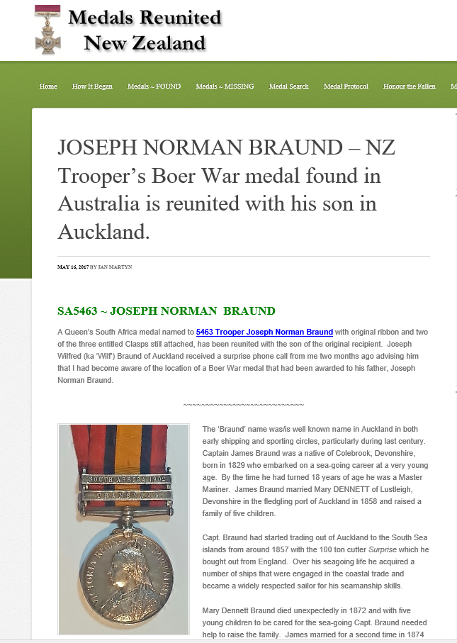
https://medalsreunitednz.co.nz/joseph-norman-braund-nz-troopers-boer-war-medal-found-in-australia-is-reunited-with-his-son-in-auckland/

Slide 40
Captain James’
Grandchildren

Slide 41
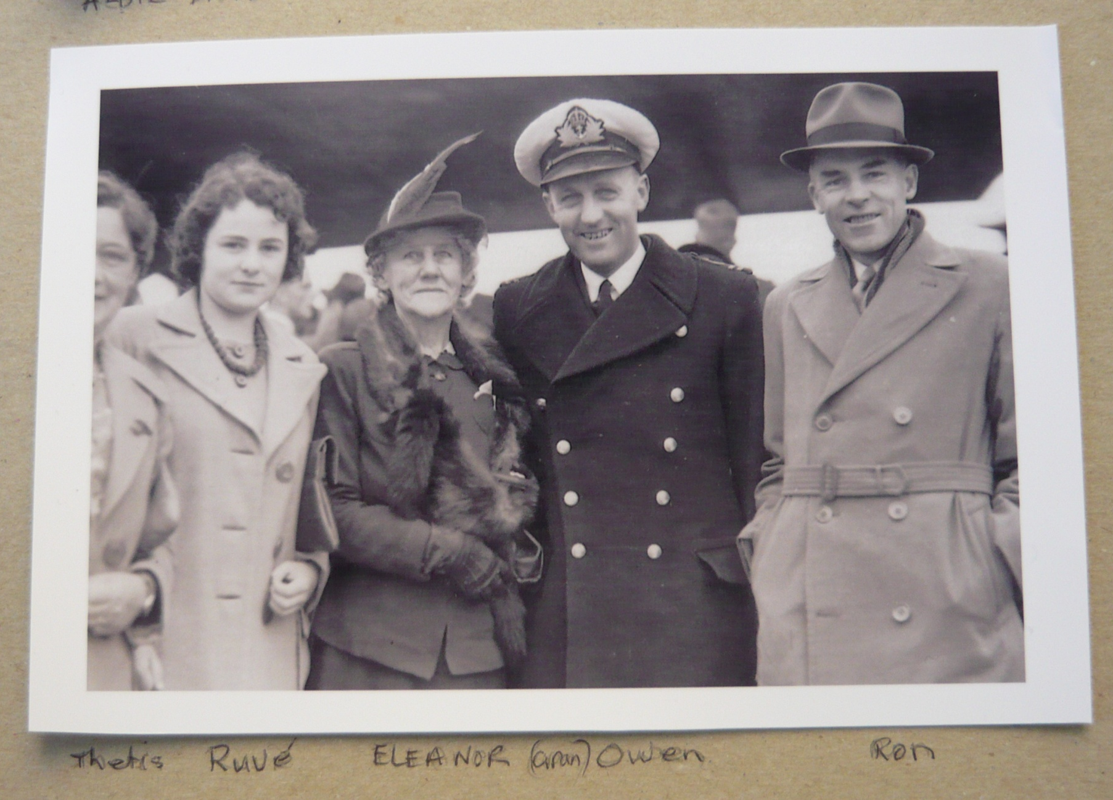
Thetis Ruve Eleanor (Gran) Owen Ron

Slide 42
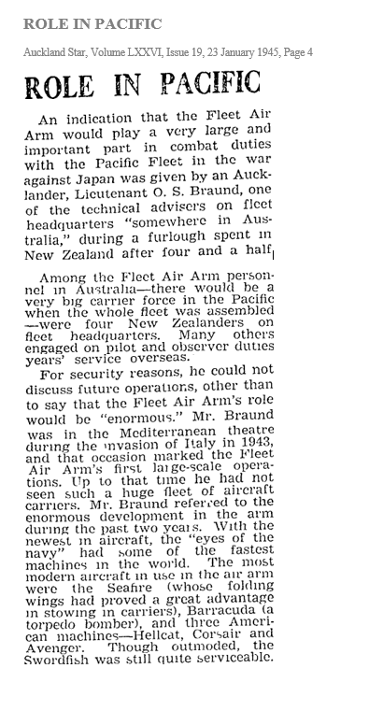
Lieutenant
Owen S Braund
Pacific Fleet

Slide 43
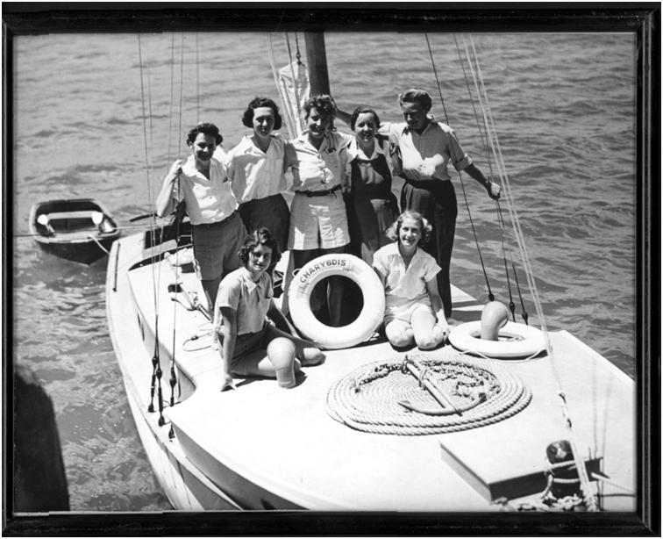
Mavis Braund
On Charybdis

Slide 44
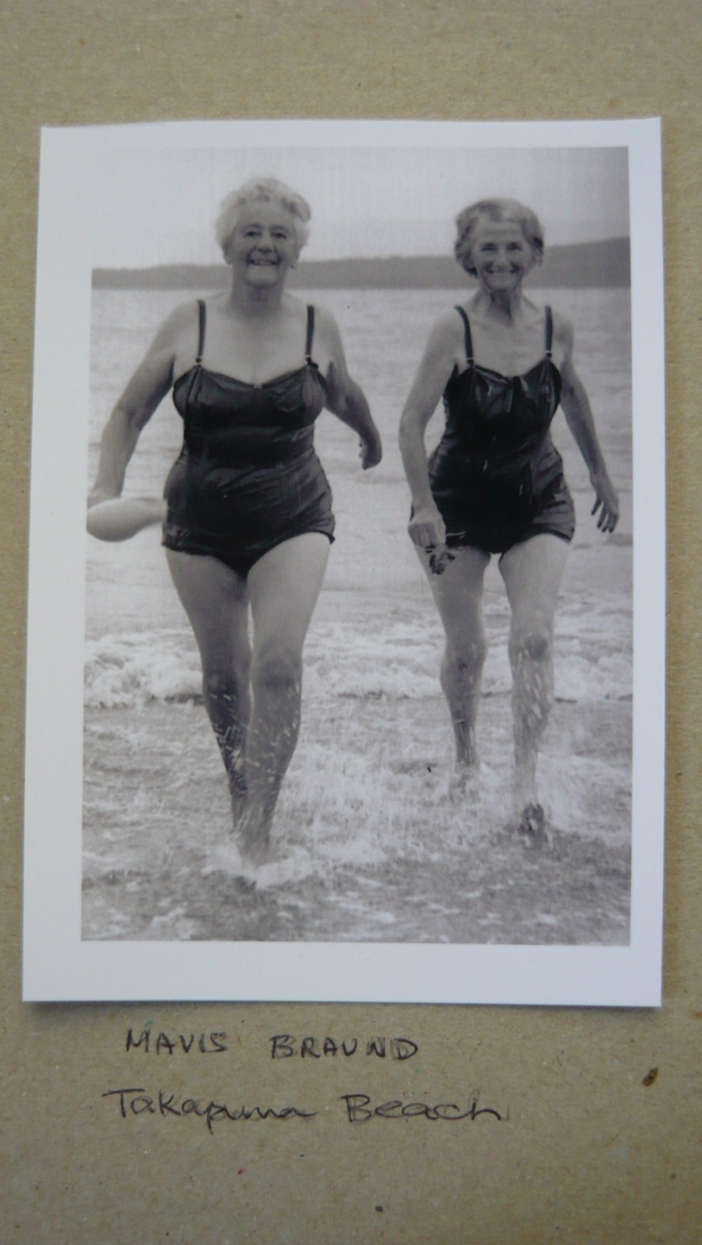
Mavis Braund
and friend

Slide 45
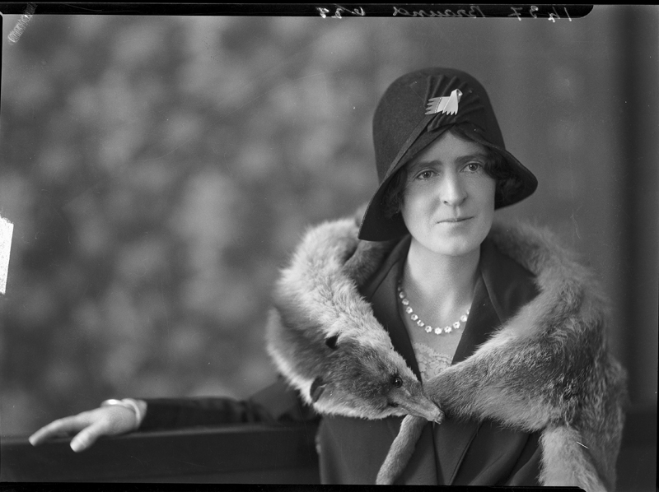
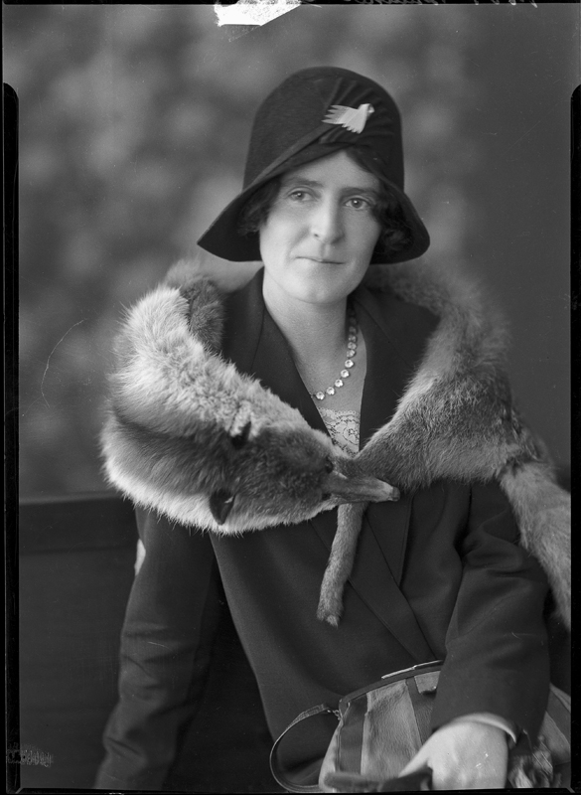
Photographs from Puke Ariki, New Plymouth
The Title is ‘Woman, Braund’
1930 -31
Looking at the Photograph and the birthdates of George Braund’s daughters, it is very likely that this is a photograph of Zeta Mabel
on her 30th birthday.
Zeta was born in 1901 and died in 1963
age 62, a spinster.
She is buried in Te Henui Cemetery
in New Plymouth

Slide 46
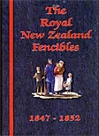
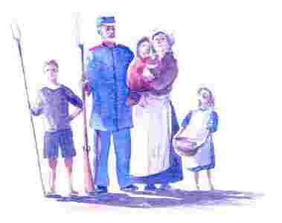
Thomas Steel
Fencible

Slide 47
Thomas Steel
Entry in ‘The Fencibles’ Book published by The Fencibles Society of New Zealand
Steel Thomas Oriental Queen
Thomas b. 1807 at Aldingbourne, Sussex, England a carpenter. He enlisted at Plymouth aged 20 years with the Royal Marines.
His height, 5’6”, fresh complexion, hazel eyes and black hair.
He was promoted to Quarter Master Sergeant by 1840 stationed in Plymouth and Pembroke, West Wales where he was admitted to Greenwich Hospital pension of 25 pounds per annum. He left West Wales with his wife Margaret Hunt (b.1807) and their 5 children.
Sarah Ann b. 1836
Elizabeth b. 1839
William Henry b. 1841
Thomas b. 1844; and
Frederick b. 1847
He built a small cottage at Onehunga and lived there for many years. It is reputed he had visitors of high rank and he and his daughter Susan, did dine, among others, with the Duke of Edinburgh in 1869. He was fond of telling his many stories of notability and claimed to receive two pensions. They moved to Darby Lane, off Queen Street, Auckland, and Parnell where Thomas worked with his son-in-law, Alfred Chitham.
His wife Margaret kept a boarding house at Parnell until her death in 1883. He died in 1895 and both are buried in Symonds St. Cemetery, Auckland.
Oriental Queen was the boat in which a contingent of ‘retired’ British Military Soldiers arrived in Auckland and were subsequently known as the Fencibles – a reservist force called on for the Waikato Wars and other periods of unrest.

Slide 48

SOUTH ISLAND BRAUNDS

Slide 49

George Braund Woodman
Arrived 1851
Burke Manuscript
Christchurch
Library
-
A record of
settlers in old
Canterbury

Slide 50

The house to the extreme Left was constructed by George Braund Woodman in 1858. Originally a carpenter, Woodman (1826-1890) became a partner in the road contracting enterprise of Woodman & Wright, using much of the profit to make pastoral investments in the Ellesmere district.
Woodman was also the first Publican of the Devonshire Arms Hotel, original home of Latimer Square's Christchurch Club. Dating from 1852, the Devonshire Arms on the south-east corner of Durham and Peterborough Streets was rebuilt in 1876 as Barrett's Family Hotel to the design of the renowned William Barnett Armson. Subsequently renamed the Gladstone Hotel, it was one of the city’s oldest hostelries, being demolished in 2005 to make way for an office building. Parts of the 1876 structure have been incorporated in the new building.

Slide 51
Mystery Braunds

Slide 52



No 422 – Private William Braund
2nd Regiment, Waikato Militia

Slide 53

Caroline
Clarissa
Braund
Resided in Blenheim
1878 – What a year !!
Advertising herself as a nurse 8 June
Charged with non-payment of £5 by Mary Patrick, dressmaker 28 August
Elizabeth Smith was charged with unlawfully assaulting Caroline 28 August
Tried for ‘wilful and corrupt’ Perjury 2 September
Assault by iron bucket (alleged) 4 September
Case heard in Supreme Court for Perjury 10 December

Slide 54
Who do they belong to…
James Arthur Braund - drowned Aged 17
William Braund - in the boat with
James Arthur Braund
William Braund - drowned Manukau Harbour
William Braund - member of the Waikato Militia
William Henry Braund - died Christchurch –
Armagh Street Men’s shelter
Caroline Braund - Blenheim court cases
J M Braund - purchased land in the Waikato 1848
Maurice Braund Catford - emigrated to Wellington
Brawn Family - Auckland

Slide 55



Spotted entering and exiting New Zealand in 2009
Michael Braund
Chris Braund
Janet Braund Few

